Slide 1
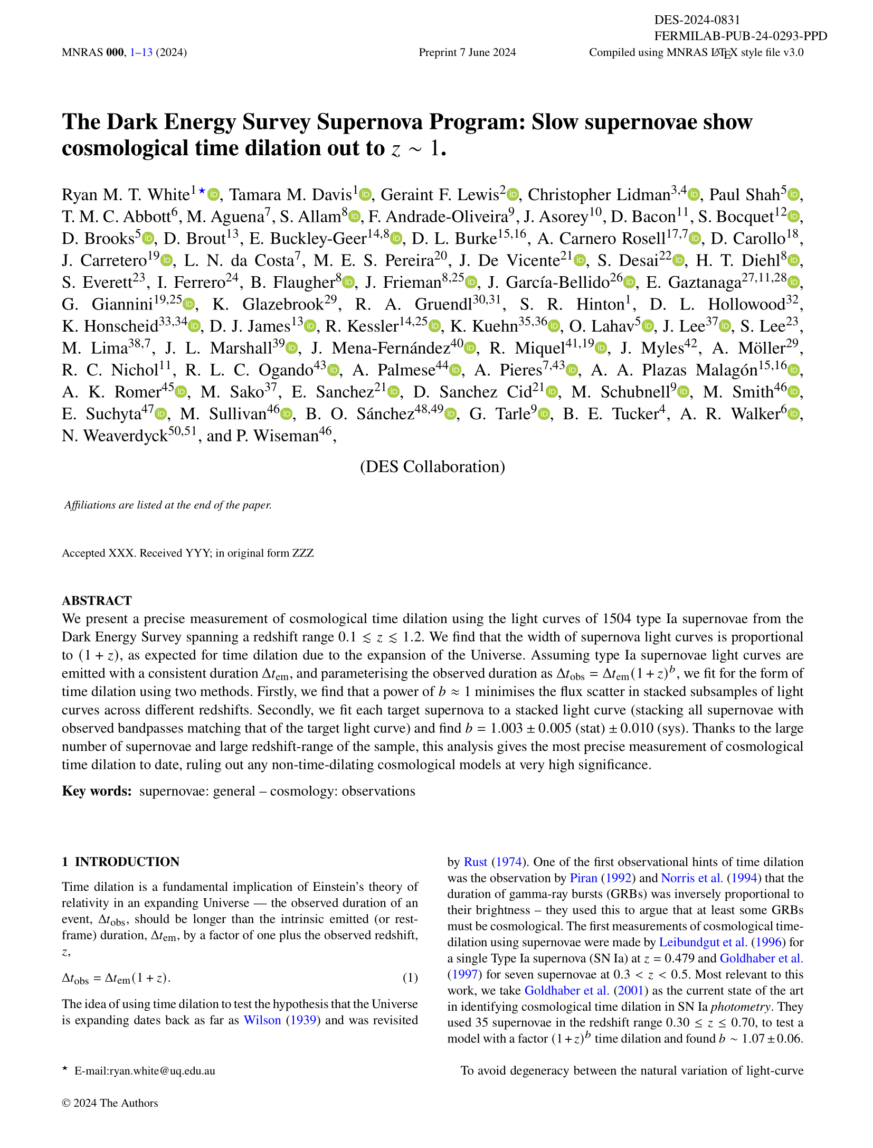






Exploding stars show us that time slows down in the distant Universe!
This work is the combined effort of a *lot*
of very smart people…
So many people from so many places that we had to put the places at the end of the paper!
Here’s the tl;dr…
For almost 100 years we’ve known that the Universe is expanding. Our models of an expanding Universe predict that a very far away clock will tick slower than one right next to us – something called cosmological time dilation. In this paper we treat exploding stars like clocks, using more of these and at higher distances than ever before to measure time dilation. Using the most data-driven approach so far, we find… pretty much what we expected! With the quality of the data from our collaboration, the Dark Energy Survey, this is the most precise detection of cosmological time dilation yet.
Here’s the background:
What we’re looking for in the paper isn’t a new idea; using exploding stars, supernovae, as clocks was proposed 85 years ago! Lots of people have used these and other transient light sources to quantify time dilation before…
Cosmological time dilation is yet *another* prediction that can be traced back to Einstein!
Time
Space

Slide 2
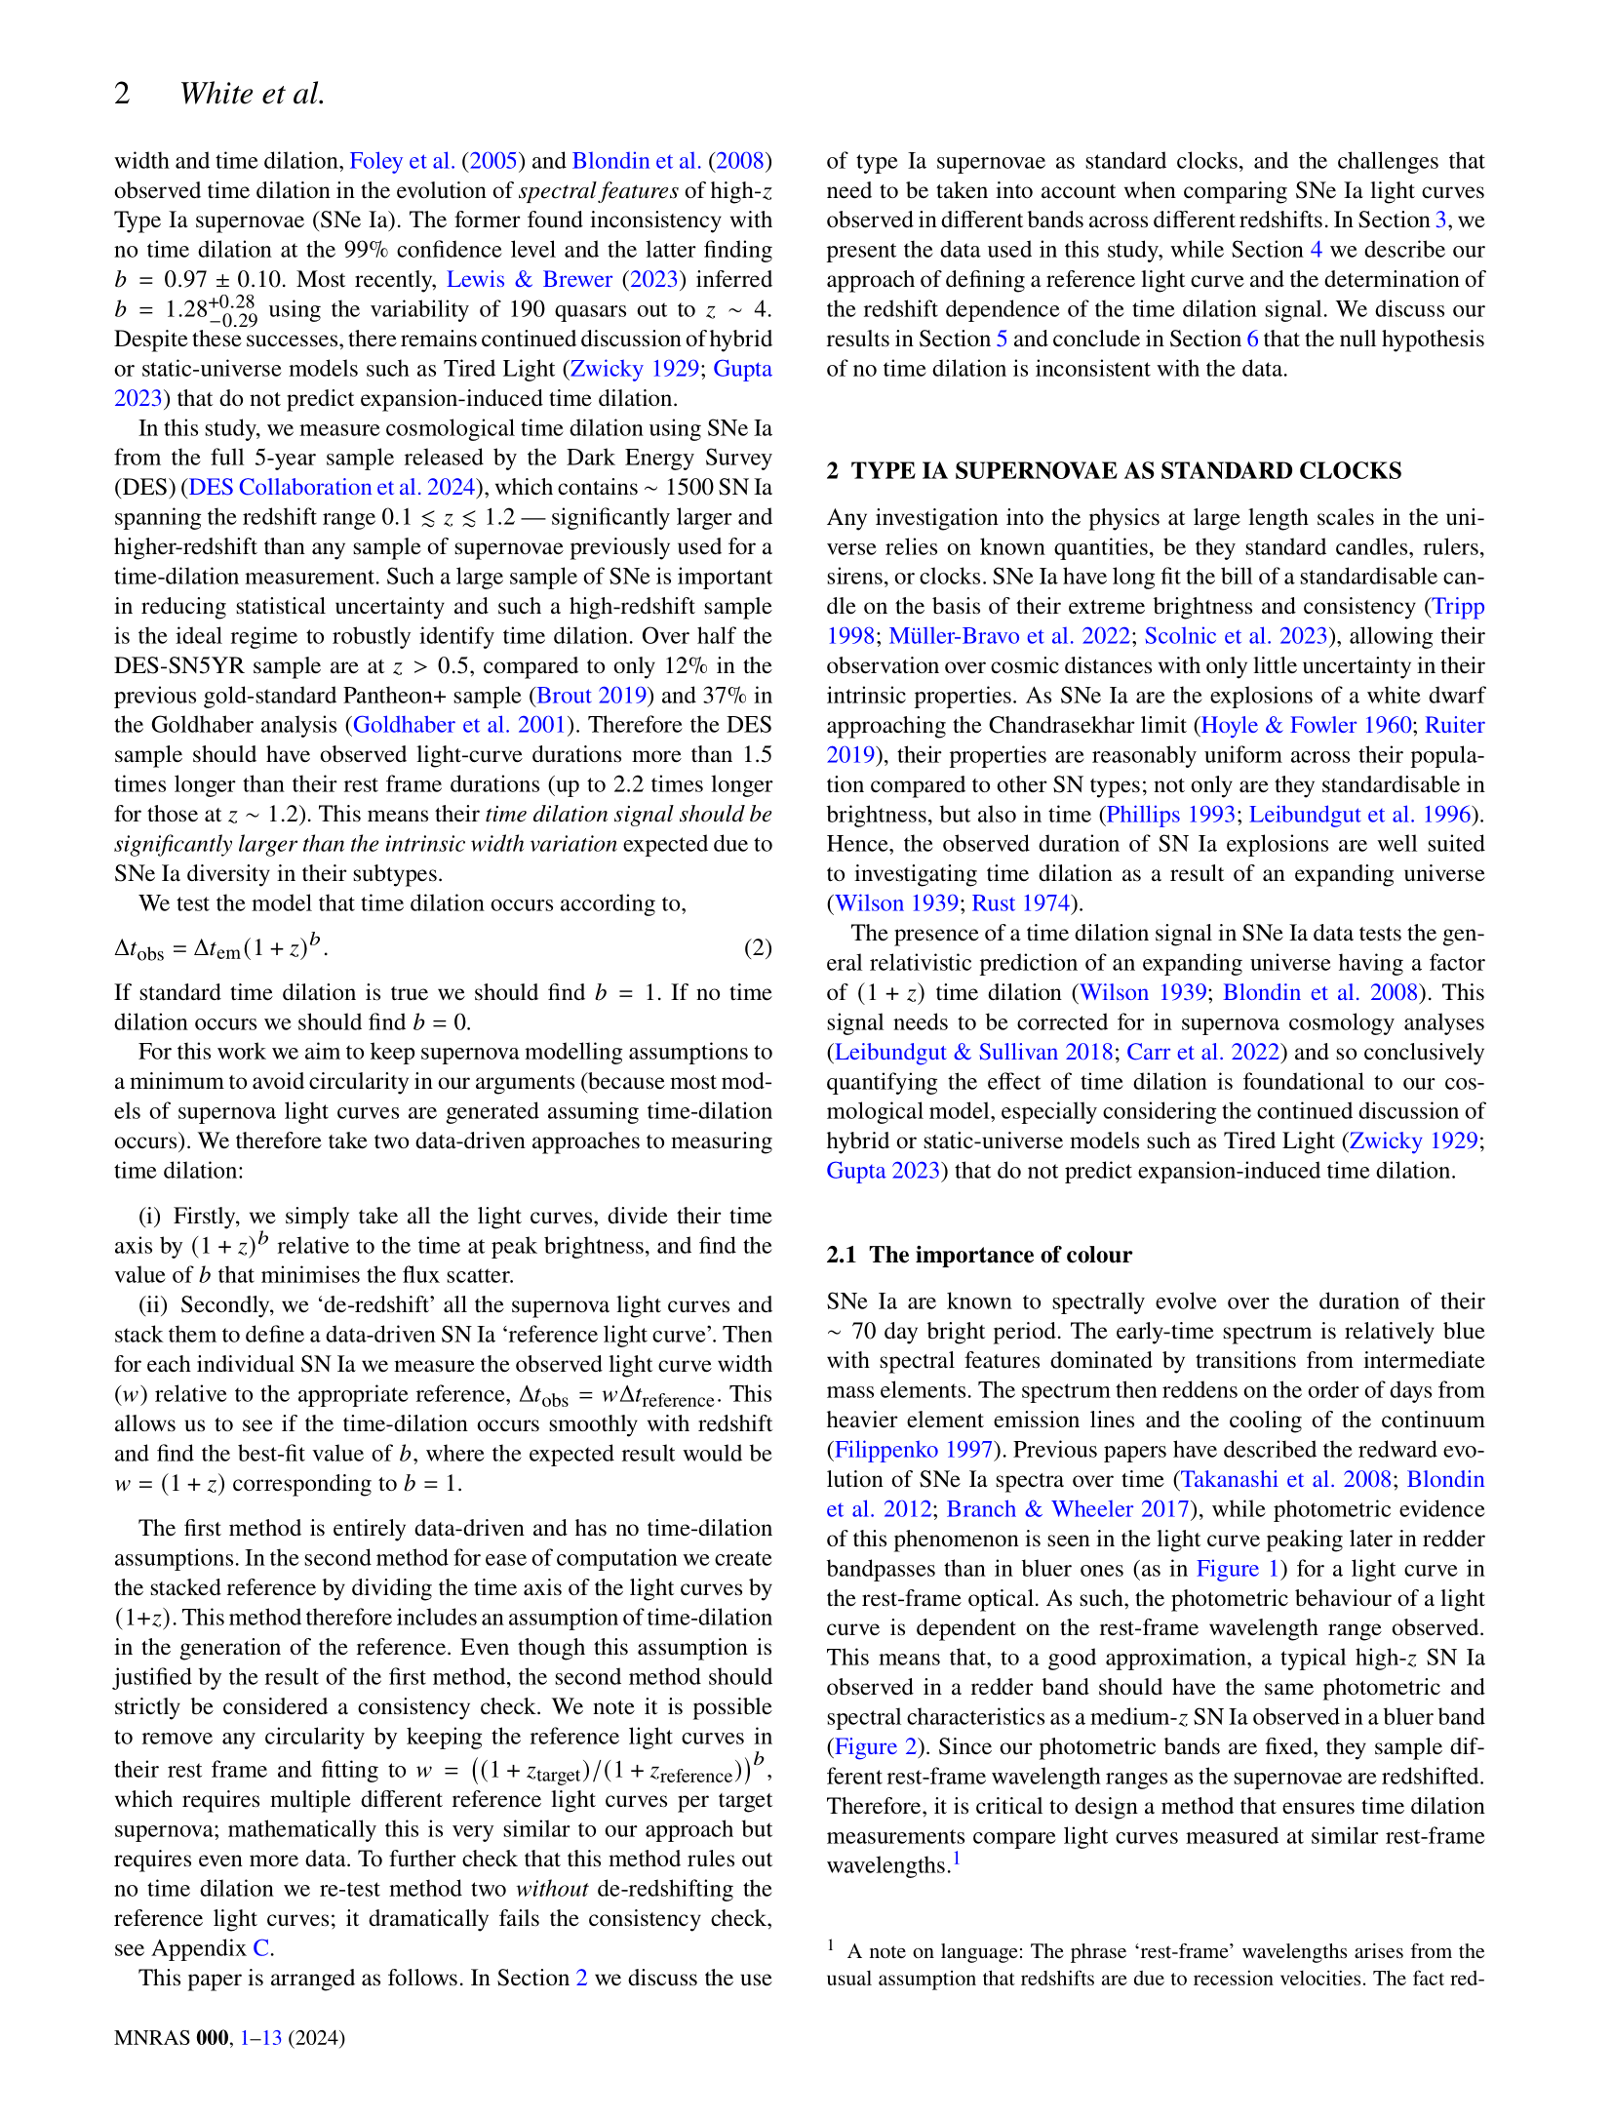







































… seriously, this is something that lots of smart people have looked at before!
It’s important to use the most distant supernovae possible for these types of studies. The further away a supernova is, the stronger the time dilation signal! This lets us find the signal amongst the noise.
We want to be really sure about how much time dilation there is as we correct for this in cosmological analyses.
To detect time dilation we can compare how different supernovae change over time.
Type Ia supernovae are the result of ‘white dwarf’ stars exploding. These white dwarf stars are the super-compact remnant cores of stars that have shed their outer layers – kind of like the skeleton left over after we die. Some of these stars steal extra material from nearby stars while in their white dwarf phase. When they steal so much matter that they reach a critical mass they explode! Since all these similar stars explode at this
same critical mass, Type Ia supernovae all look pretty much the same no matter where they are!
Type Ia supernovae get
redder over time,
which means that we need to be
careful when
we compare them…
Day 0
Day 20
Day 60

Slide 3
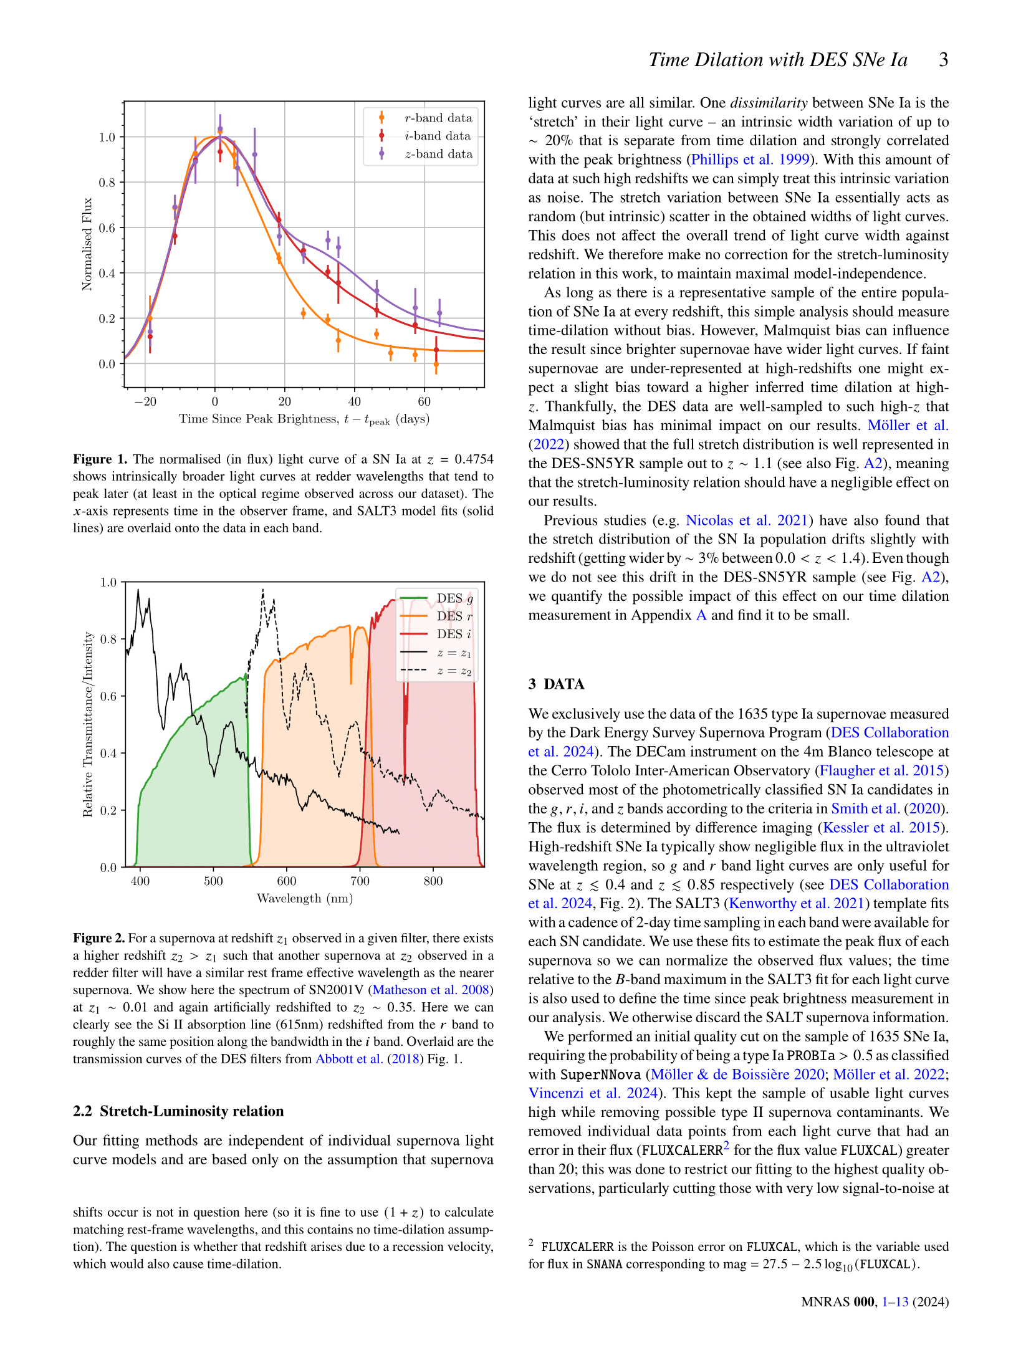
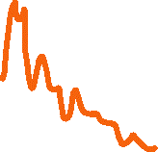




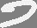
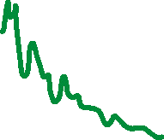
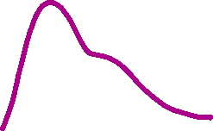

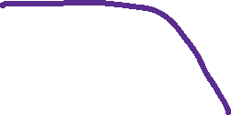

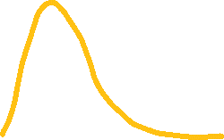

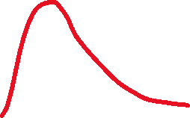
Type Ia supernovae aren’t actually as consistent as I’ve been letting on, but they do average out nicely! Some supernovae are intrinsically brighter than others and so they have ‘wider’ light curves, meaning they effectively explode for a longer duration. On the plot to the left, one of these special supernovae would be a bit taller and a bit wider!
This has the same effect as time dilation and this makes our analysis a bit trickier. Luckily, the Dark Energy Survey found so many supernovae of all types that we don’t need to correct for this; it all averages out. Even if it didn’t average out, this affect is not as strong as the time dilation.
Orange-ish
Red
Infrared
How bright the supernova is
Days since the explosion
This is what our data looks
like! We have ‘light curves’
of 1504 unique supernovae,
in multiple colours
Far away
supernova
What data do we have?
Close supernova
Brightness of light we see
Galaxy during supernova
Galaxy before or after supernova
Just the supernova!
Bluer
Redder
Colour of light we see
The 4m Blanco Telescope
at the Cerro Tololo Inter-American Observatory observed thousands of supernovae for the Dark Energy Survey. 1504
of them made the
cut for this paper!
The expanding Universe makes distant blue light appear red to us – we call this ‘redshift’. This plot shows that the colour spectrum of a supernova that’s far away is redshifted compared to one that’s close by

Slide 4
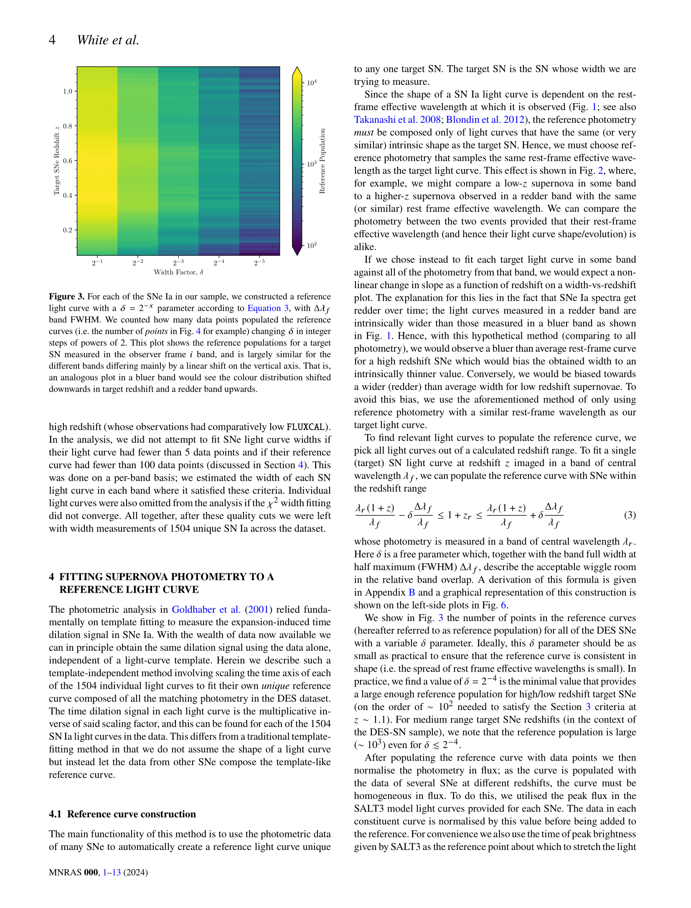



A long time ago in a galaxy far, far away…
Space and time
So we know that supernovae appear differently depending on the colour in which we look at them. We also know that redshift means that when we look at red light from a far away supernova, we’re actually looking at intrinsically blue light that’s been shifted to the red as the light has travelled to us.
If we want to compare supernova light curves across different redshifts, we need to account for these effects. We proposed using a mathematical selection function*
to carefully choose light curves at certain redshifts and in certain colours so that we get a sample that should all have the same shape.
What do *we* do in the paper?
This equation essentially says that if we want to compare with a supernova at a very high redshift, we need to collect light in a redder filter so that we’re seeing the same type of stuff!
Since we have a finite amount of data, we can’t choose light curves that’ll have exactly the same shape, but the sheer number of supernovae with DES means that we can pick lots of light curves that are pretty close!
If time dilation is real, we should see that supernovae take longer at higher redshift (from our perspective). That means that if we stack light curves from various redshifts that should have the same shape, the higher redshift ones will appear wider!
Our method is unique in that we use *only* the data from the Dark Energy Survey – no other supernovae were hurt in the making of this paper.
*For astrophysics, we’re kind of light on the math in this paper!

Slide 5
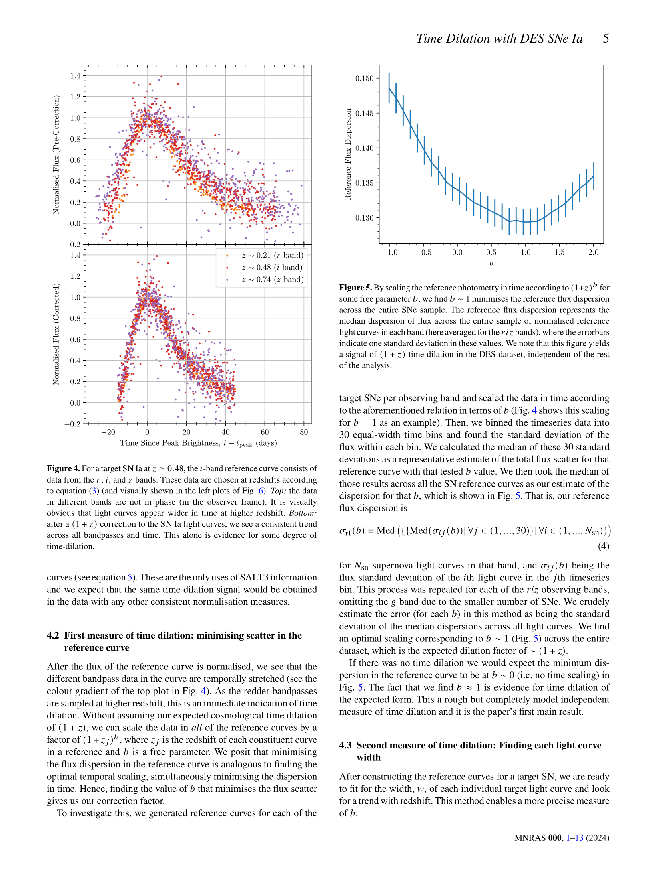
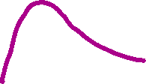
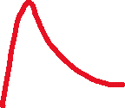
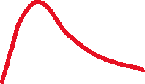
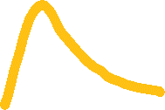
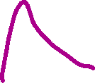
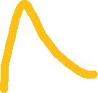
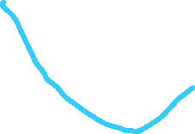
This is what it looks like when we stack them…
No time dilation
The error in matching up the colours
Time dilation we expect
How bright the supernova is
And this is what it looks like when we measure and correct for time dilation
How much time dilation there is
(lower values of error is better!)
What we did on the left column was just for one individual ‘center’ redshift value (in that case, trying to match the shape of a red light curve at redshift 0.5). We can do this for all of the 1504 DES center redshifts and find the time dilation value that best matches up all of the colours.
We fit a factor of time dilation of (1+z)^{b}, where z is the redshift value and b is just some number; b=0 means no time dilation and b=1 is the time dilation we expect in our expanding universe. The plot at the top of this column shows that when we fit for all of the light curves, we find b=1 matches up best. Cosmology can rest easy! For now…
Days since the explosion
When we take orange light from redshift 0.2 supernovae, red light from redshift 0.5 supernovae, and infrared light from redshift 0.75 supernovae, the light curves should look the same! But the top plot shows that the redder light curves (from higher redshifts!) are *wider*. This is time dilation in action!
This part of the paper describes one way that we can numerically measure time dilation. If we squish the light curves along the time axis by a certain amount so that all of the different colours line up, we’ve got our time dilation measurement!

Slide 6
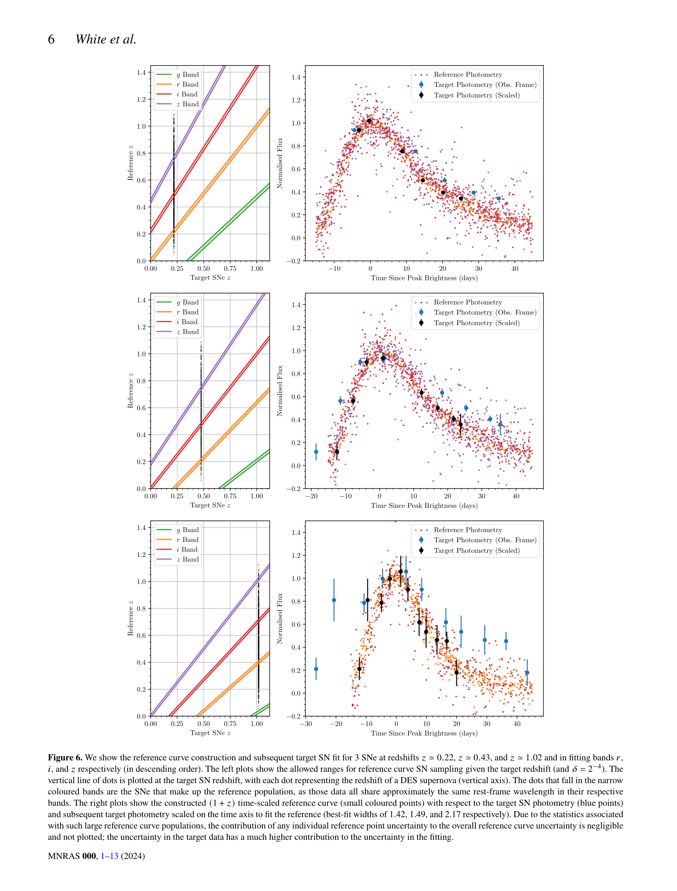


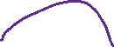


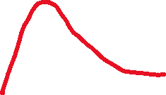
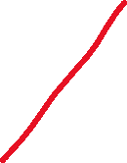
Another way that we can find time dilation is to find the ‘width’ of each individual supernova light curve.
We can make the ‘stacked’ light curve (corrected for time dilation using the result from before) and fit an individual light curve to it to find how wide it is.
Our stacked curve
The raw data for this supernova
The raw data now fit to the stacked curve
How bright the supernova is
This is what we expect the data to follow
Days since the explosion
Each black dot is an individual supernova that we have light curves for
This is how we choose what light curves go into the stacked light curve – no math needed here. Wherever the black dots intersect the coloured bands, we can take those light curves observed in that colour and put them in the stacked curve! These light curves should all have the same shape.
All light curve redshifts
Redshift of the data we’re fitting
Here’s one of the unedited plots from the paper now that we what’s going on!

Slide 7
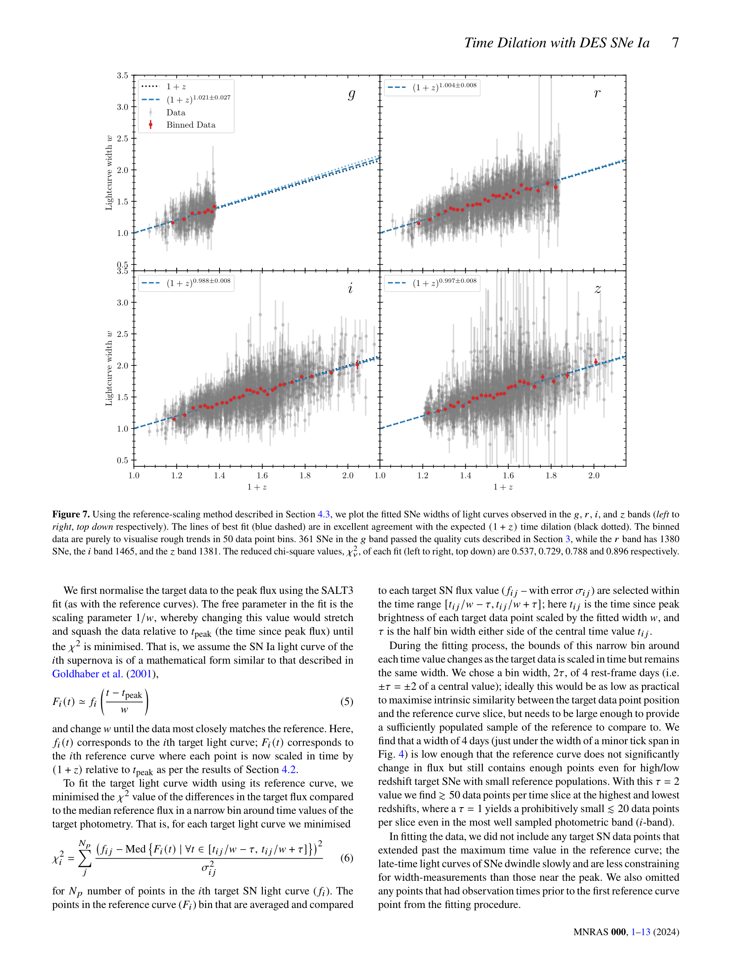
Looks good!
Looks good!
We need to check that our method works for all the observation colours available to us. No need to stress because this plot shows that it does work!
Looks good!
Looks good!
This is us describing the math and code that we used to find the widths of the light curves. We don’t use a particularly difficult or advanced method, but it’s accurate for our purposes and runs quickly on a personal computer.

Slide 8
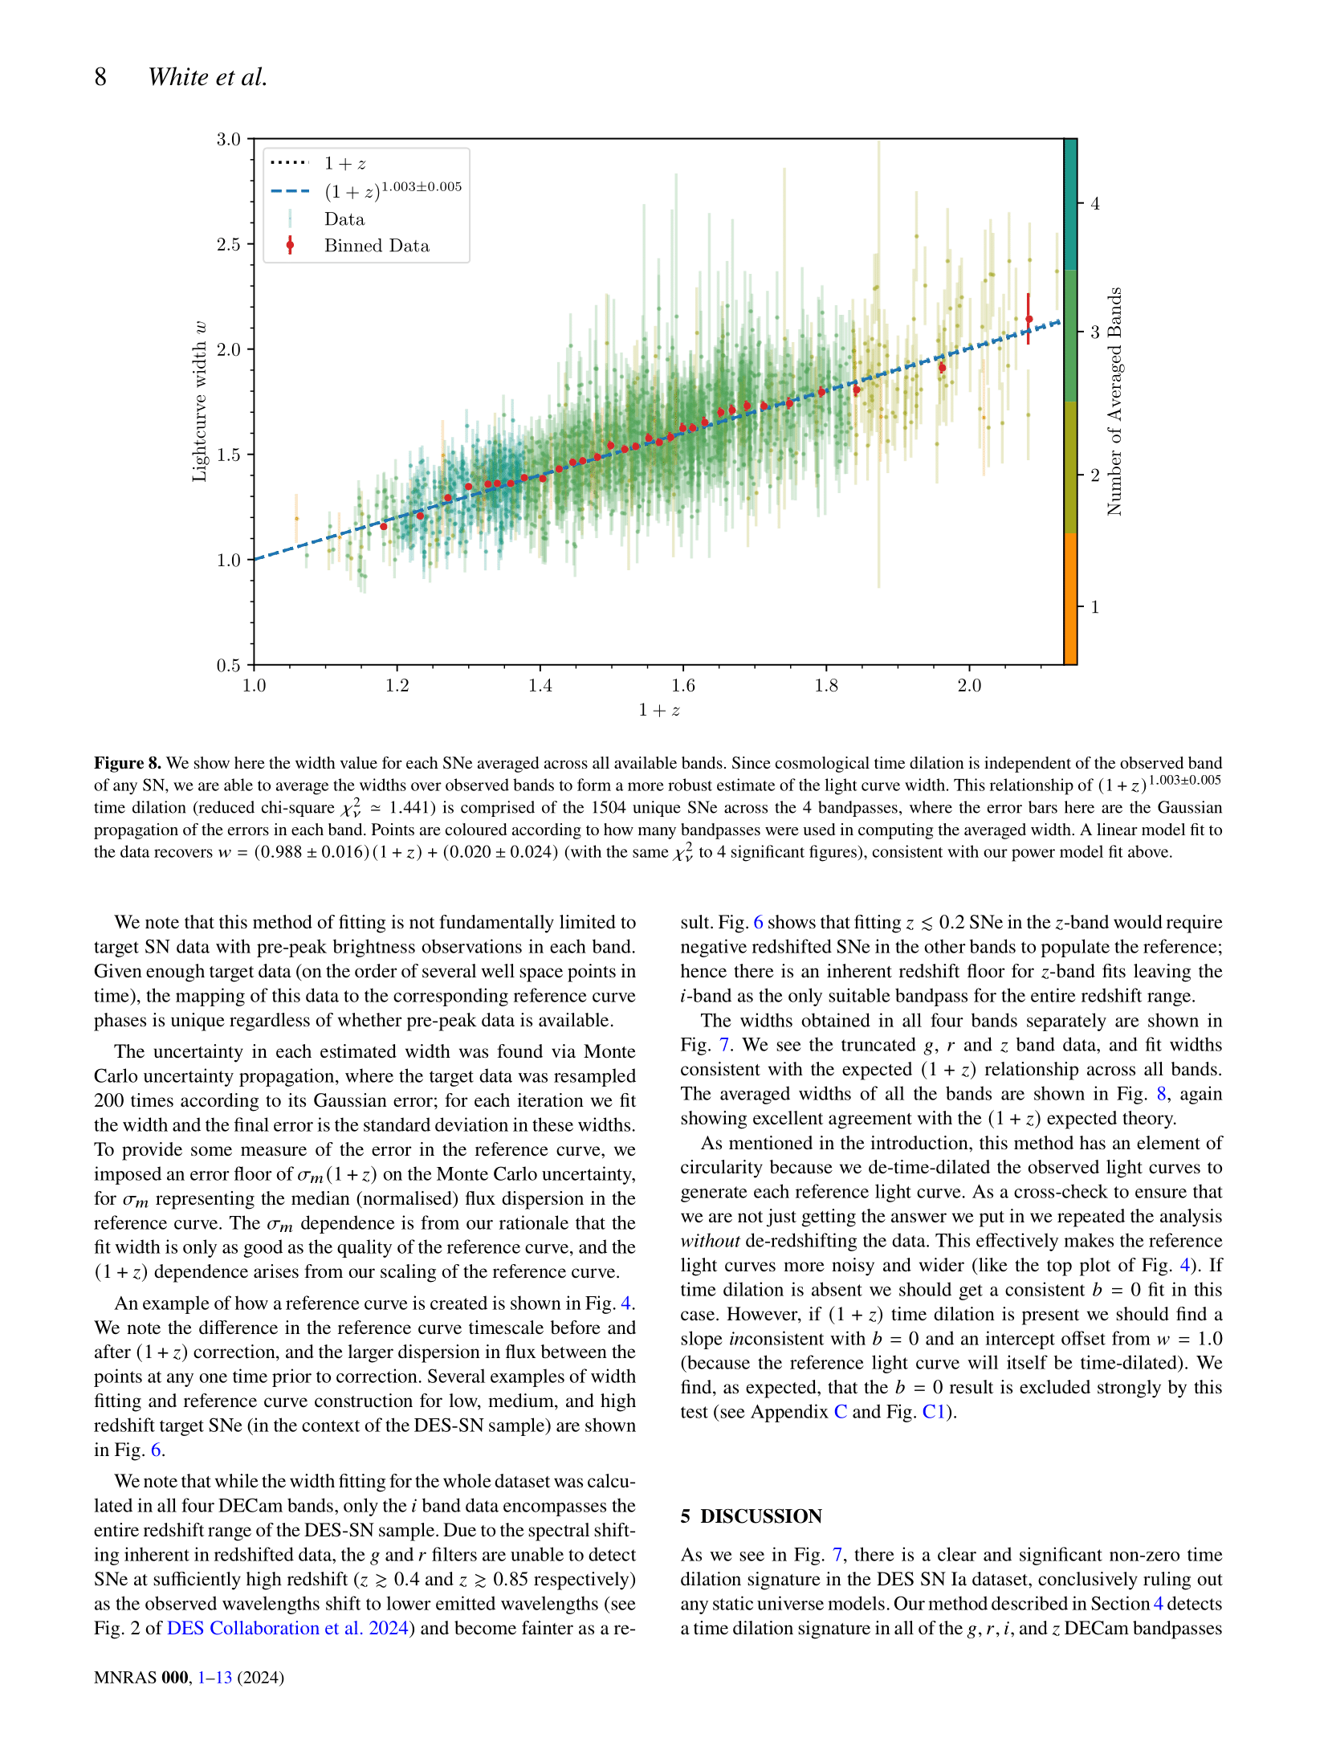


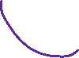
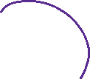

Our line of best fit
Each dot on the plot is our estimated width for an individual supernova light curve
This is what we do see with time dilation
Width of the supernova light curve
This is what we’d see with no time dilation
Redshift of a supernova
Remember that we’re trying to find time dilation of the form (1+z)^{b} where b = 0 means no time dilation and b = 1 is the time dilation we expect.
With our method we find… *drumroll* … b = 1.003±0.015.
This means that our data is consistent with what we expect from theory.
In science we usually can never claim a perfectly precise result and need to discuss our uncertainty in our model fits; this is where that ‘plus or minus’ 0.015, or ±0.015, came from in our result. This means that we would normally expect the ‘true’ result (that we’re trying to find) to be somewhere in that range of our found result.
We mentioned before that we already corrected for time dilation in our stacked light curves. To be sure that we’re not just getting the result that we put in, we do it all again later without correcting beforehand. Spoiler: it’s only possible to get a real signal when we correct for it in our stacked light curve!
Now let’s talk about what we found
0.988
1.003
1.018
(on the next page)
Probably not
over here.
Is the true value here?
Or here?

Slide 9
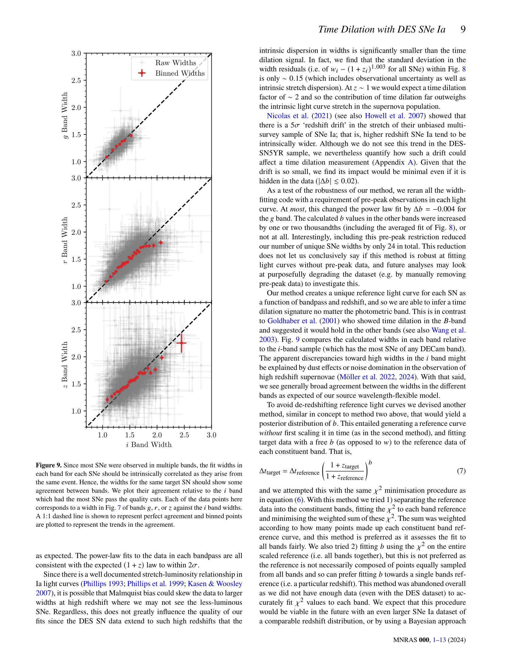
You might expect that we see preferentially brighter objects when looking very far away – imagine your friend shining a flashlight at you as they walk away. Eventually, when they make good distance, you won’t be able to see them anymore unless they get a brighter flashlight!
Interestingly, the Dark Energy Survey Type Ia supernova sample avoids this bias quite a lot! Even if this bias were present in our data, it would only contribute <15% to the light curve widths which is very small compared to the >100% effect of time dilation at high redshift. At worst this would skew our fit, but we would still clearly see some non-zero time dilation signal.
Green light width
Perfect agreement between colours
Near
Far
Hey, ow!
Orange light width
Wherever you arrrrre
Do not go gentle into that good night
Infrared light width
Red light width
We need to check to make sure that we’re finding roughly the same width in all of the different colours we look at each supernova in. On average, we do!
We also looked at another, more advanced method that would mean that we *wouldn’t* need to correct for time dilation in the stacked light curve before fitting for light curve widths. We found that this wasn’t practical as we’d need even more data than we have; remember that DES has given us the largest sample of data at this high a distance, so we’d need a truly huge dataset to do this.

Slide 10
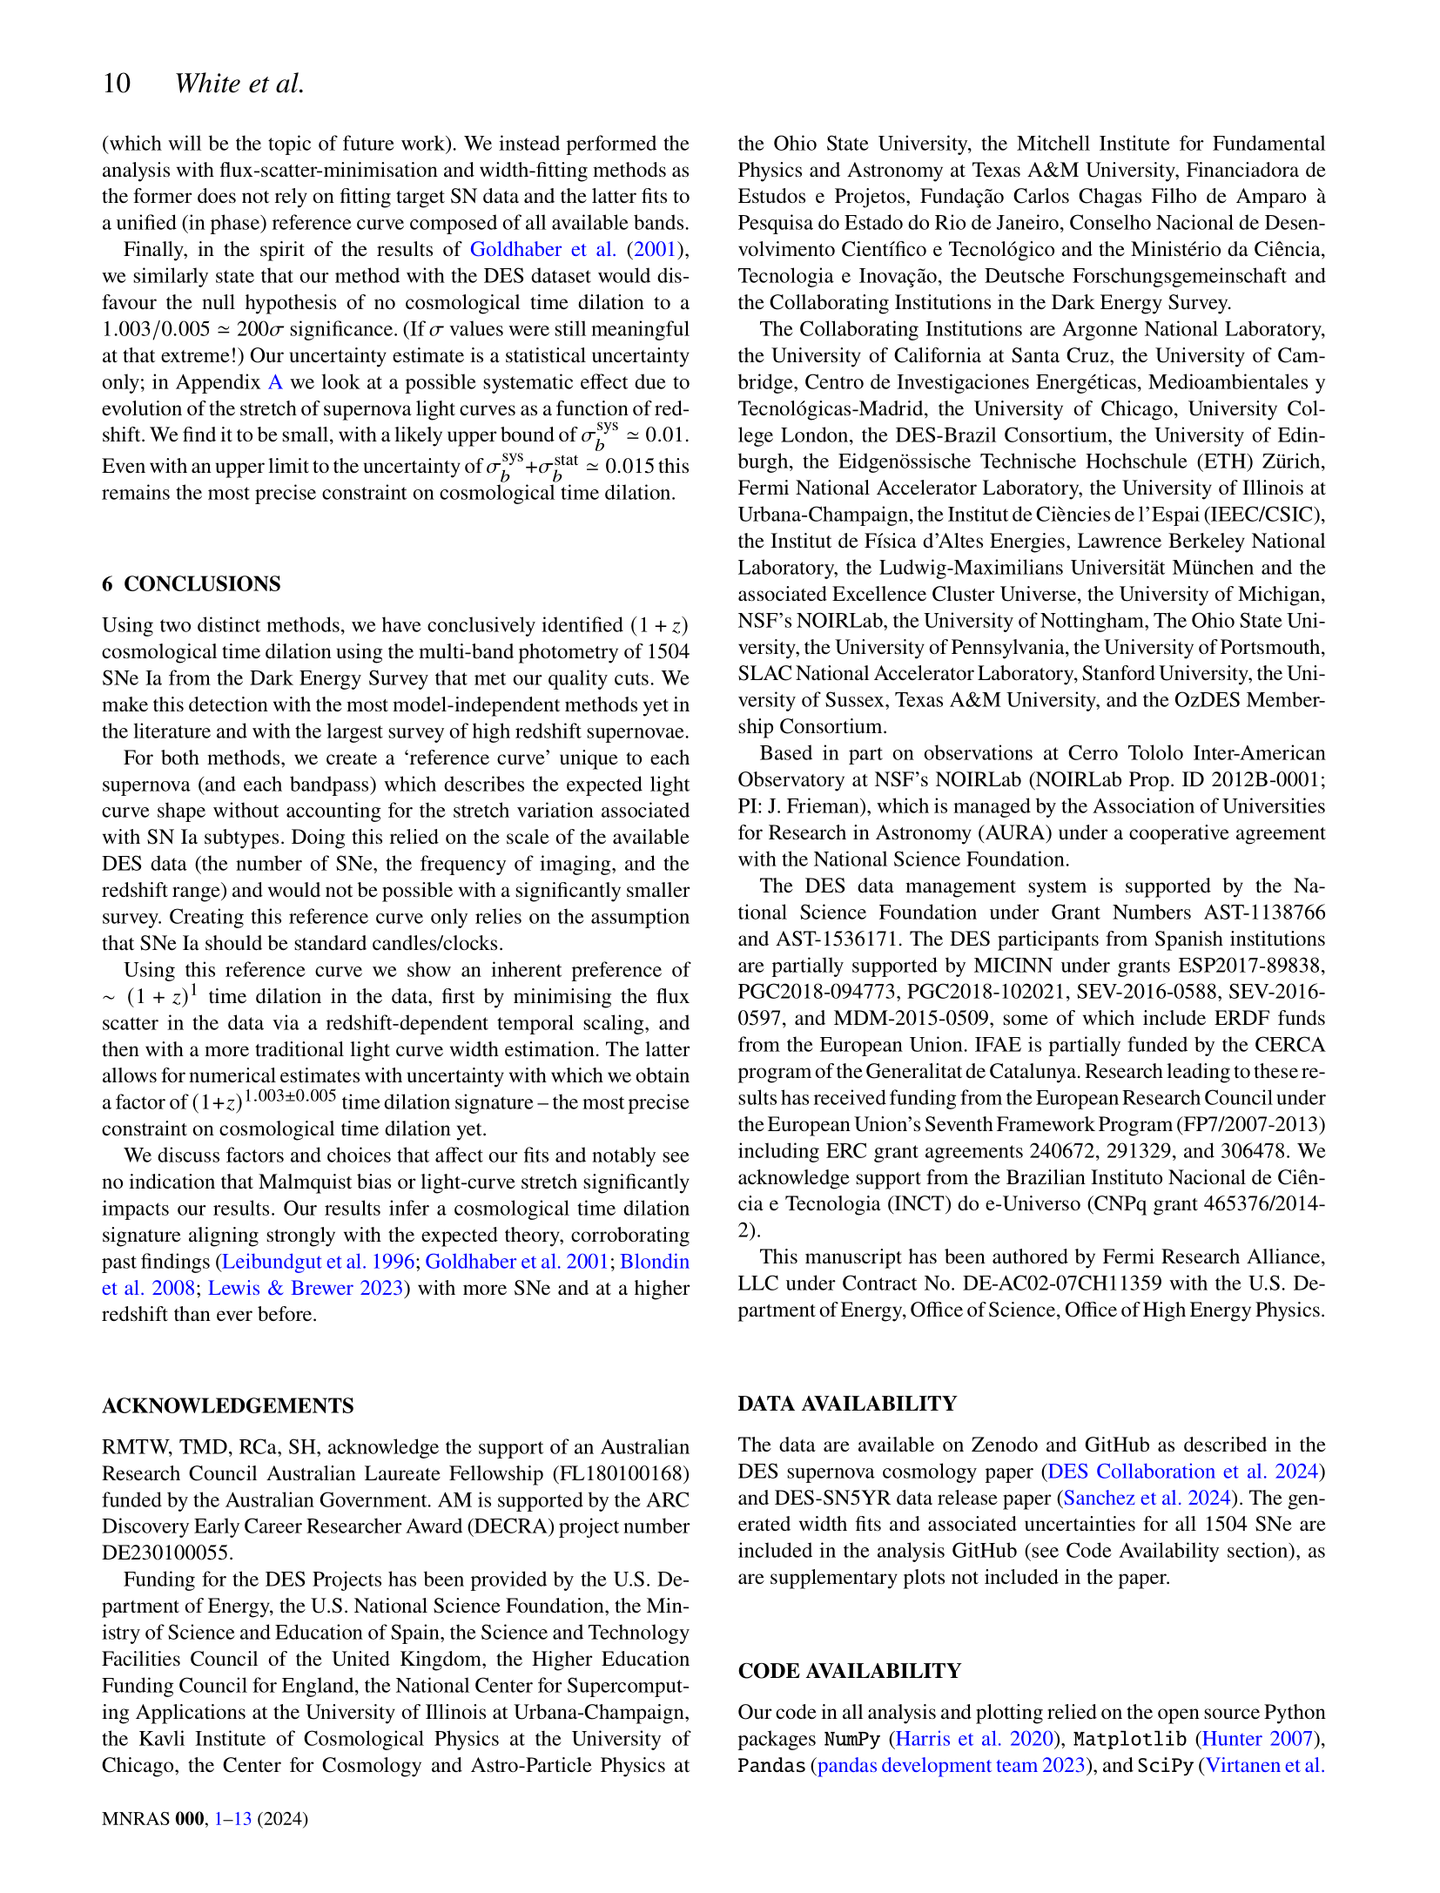






The uncertainty in our time dilation signal from our data can be precisely constrained, but there are other (physical) effects happening that make it a bit harder to nail down. Therefore we need to make our errorbars a little bit bigger with something called ‘systematic’ uncertainty.
It takes a *lot* of funding for a lot of people to allow us to do these kind of studies. Even though the light from these supernovae is raining down everywhere on Earth, it takes a huge and expensive telescope to collect it all reliably!
The take home message:
We’ve done all of this work and effectively shown what we already knew and expected. We did this mainly for three reasons: 1. we’re in an era of cosmology where it’s more important than ever to have a solid grasp of the fundamental building blocks
2. it’s a good idea to periodically check up on old results with new and shiny data
3. it’s really just super cool that we can see time dilation from exploding stars!
Time dilation is a real thing that we see in the Universe, and we’ve shown it with the most precise method and data so far
woah
…loooooots of funding from a lot of different governments and institutions.
woah
Want to try it yourself?
All of the data is now publicly available so you can go and try to reproduce our (or other people’s) results!
And now for thanks!
Dealing with this much data is only possible with programming! The code we wrote uses popular and well tested packages

Slide 11
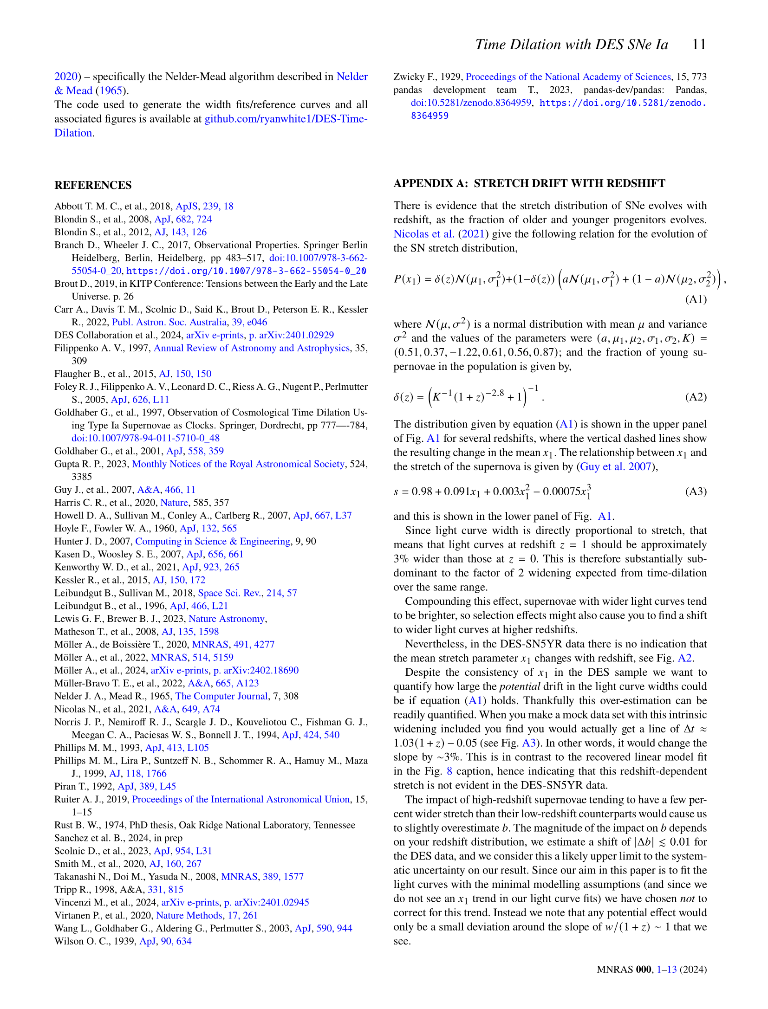
The code we wrote is also publicly available, so you can take a look at my spaghetti code if you’d like! There’s also some bonus plots on our GitHub repository that we didn’t include in the paper.
Now for some bonus content!
Whose work did we build on?
Every new piece of science builds on the shoulders of giants. We’re continuously improving, refining, finding new results based on the work that other smart people have published. For this paper we had to read a bunch of other papers to learn more about what’s been done in the past, intricacies about supernovae, and the Dark Energy Survey data!
While we were writing the paper we came across an interesting study that suggests that supernova light curves really are somewhat *intrinsically* wider at high redshift. We don’t yet know why this is, but as with any good science we can model it!
We found that this effect isn’t noticeable in the Dark Energy Survey dataset, not because it doesn’t exist but probably just because of how we take our data. Crunching the numbers shows that this ‘redshift drift’ in the width of light curves would only change our signal by ~3% if we did see it! Like before, this isn’t make-or-break for detecting time dilation, but it is important to consider with a result as precise as ours.
It’s great to live in a time when so many are given the opportunity to study the Universe and share what they find

Slide 12
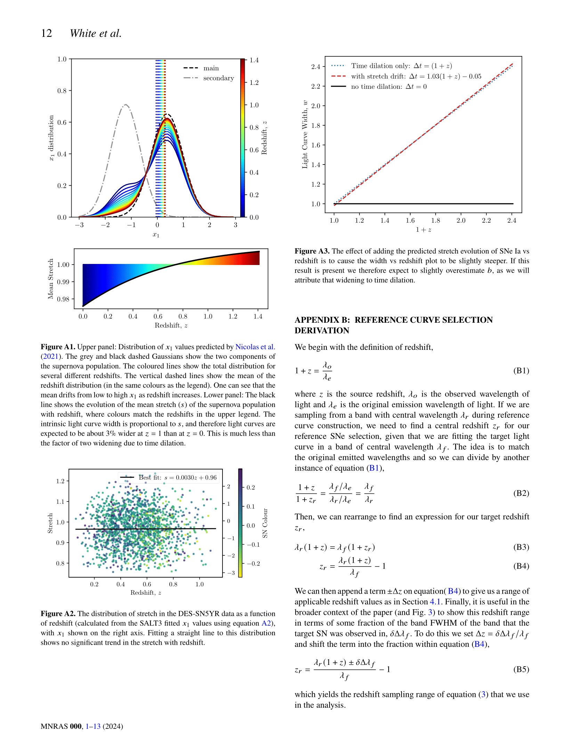

What we’d expect with no redshift drift
Width of the light curve
What we’d expect if our data had redshift drift
Redshift of a supernova
Clearly a very small effect!
Bonus content 2: electric boogaloo
These plots show what we’d expect to happen to our data with the redshift drift, and back up our claim that we don’t really see it with the DES dataset.
I was a little bit silly and repeatedly messed up this math in the early stages of the project. I wrote it out here so that everyone could see my attempt and correct me if I got it wrong! (thank god for peer reviewers and my supervisor). It’s always good to remind ourselves that we’re not infallible and talking to others helps us improve our work!

Slide 13
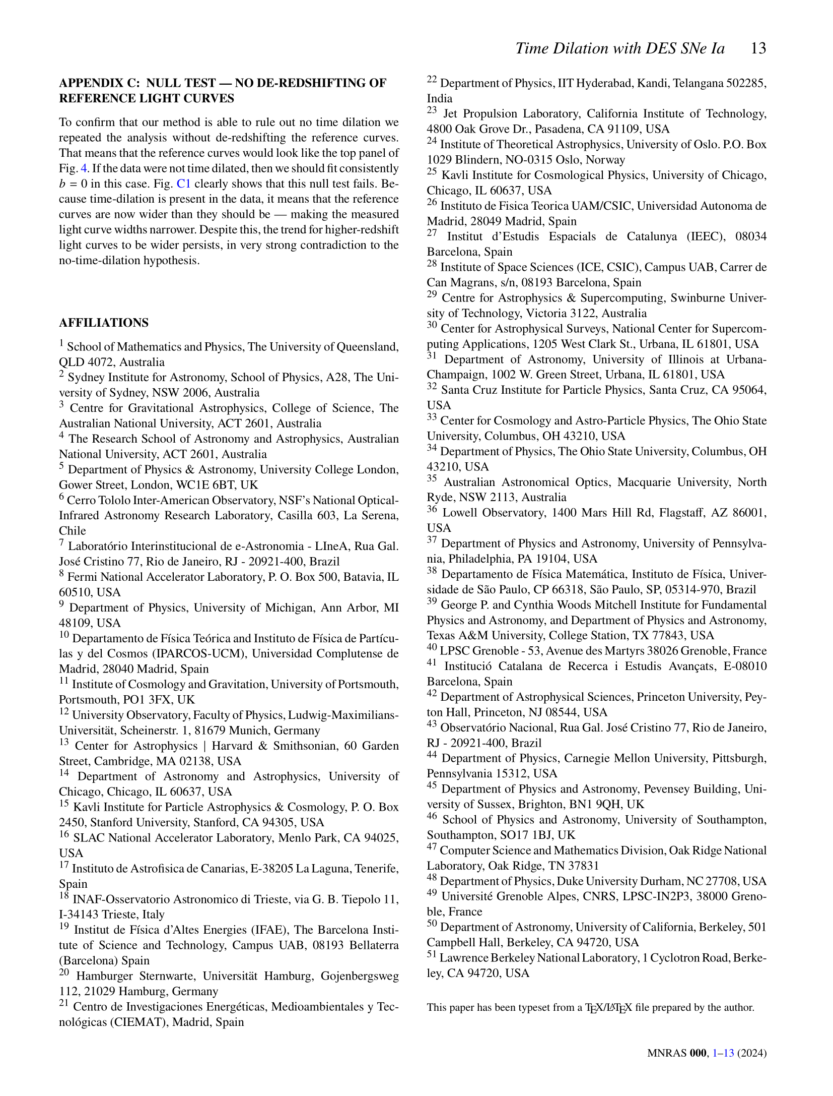






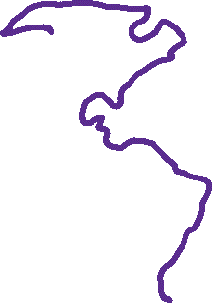



Bonus content 3: it’s the last from me!
This is where we describe how badly things mess up when we don’t correct for time dilation in the stacked light curves. See the next page to see it in action (it might help to compare with the analogous plot a few pages back).
I think space is cool
I think space is cool
I think space is cool
I think space is cool
You saw on the first page how many people contributed to this work and the Dark Energy Survey. This is (roughly) where every author’s institution for this paper is!

Slide 14
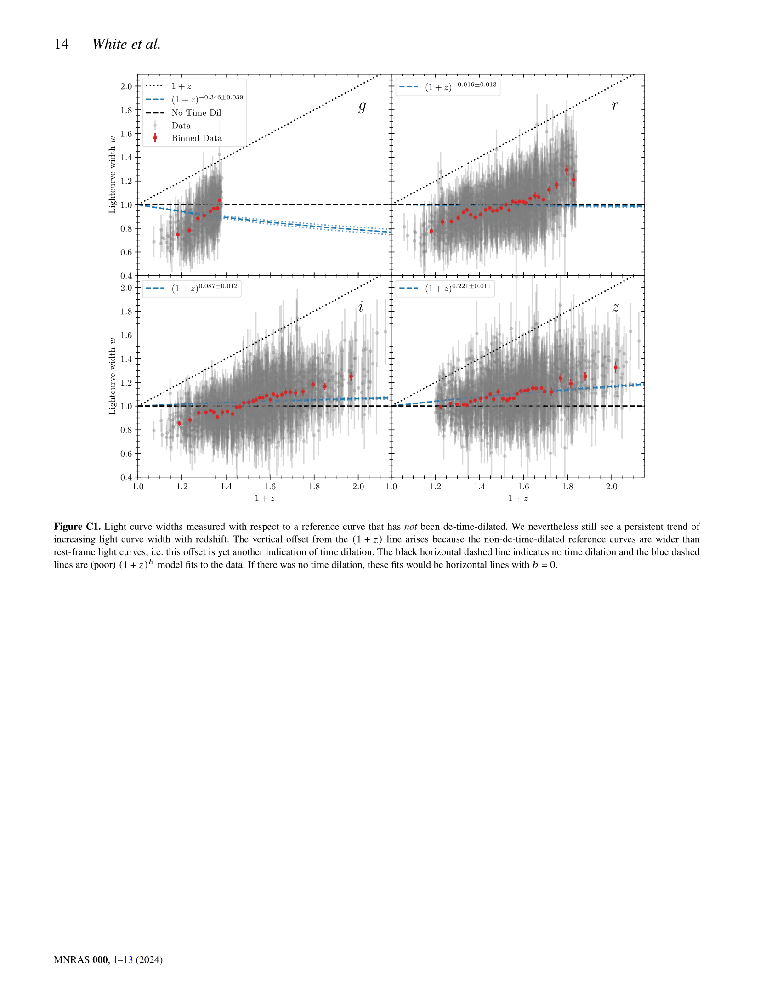





By our definition we need the light curve width to be equal to 1 at the far left of these plots. You can see that they never match up: there’s chaos when we don’t use the method properly!
Light curve width
Redshift
Congratulations on making it to the end! We’ve put a lot of effort into making the paper readable to astrophysicists, but I hope these notes were readable regardless of your background!
These scribbles were inspired by the wonderful work of Claire Lamman and Sydney Vach (who was also inspired by Claire!) Please go check out their annotated papers here and here.
I used PowerPoint to write over the paper text and plots by hand, using the XKCD font for the text (you don’t want to see my handwriting!). You can download the font at github.com/ipython/xkcd-font
Want to read more about the Dark Energy Survey? There’s a lot of cool science happening!
darkenergysurvey.org

